Slide 1
Introduction to
Neural Networks Computing

Slide 2
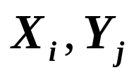
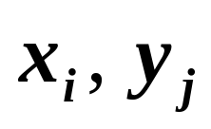

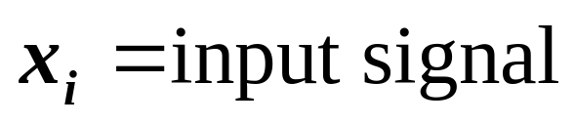

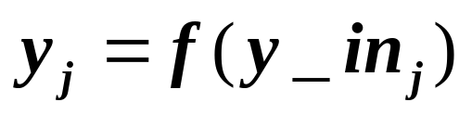






Notations
units:
activation/output:
if is an input unit,
for other units ,
where f( .) is the activation function for
weights:
from unit i to unit j (other books use )

Slide 3



bias: ( a constant input)
threshold: (for units with step/threshold
activation function)
weight matrix: W={ }
i: row index; j: column index

Slide 4
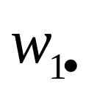
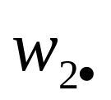
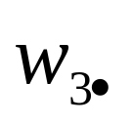
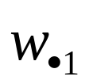
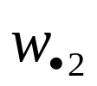
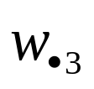
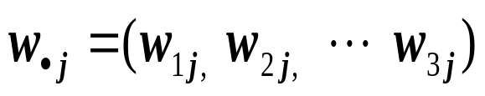
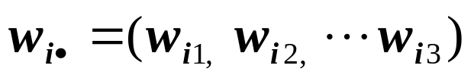
2
5
4
-1
1
2
3
3
6
1
0 5 2 ( ) row vectors
3 0 4 ( )
1 6 -1 ( )
column vectors
vectors of weights:
weights come into unit j
weights go out of unit i

Slide 5
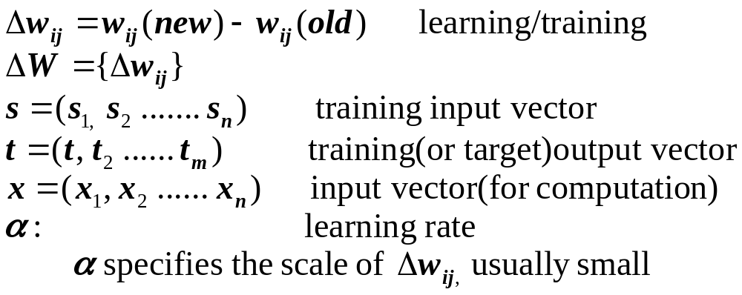

Slide 6
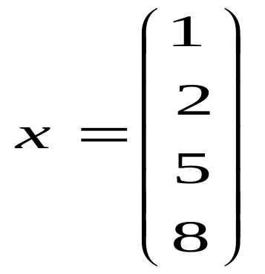
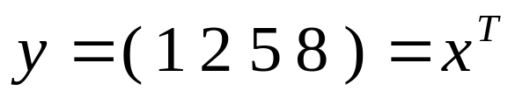
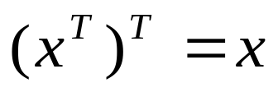
Review of Matrix Operations
Vector: a sequence of elements (the order is important)
e.g., x=(2, 1) denotes a vector
length = sqrt(2*2+1*1)
orientation angle = a
x=(x1, x2, ……, xn), an n dimensional vector
a point on an n dimensional space
column vector: row vector
X (2, 1)
a
transpose

Slide 7
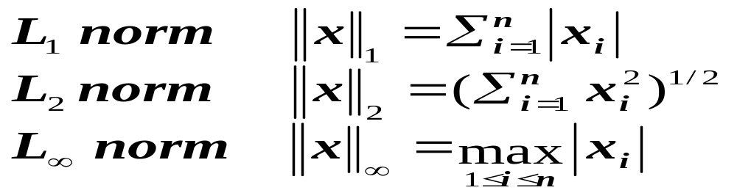
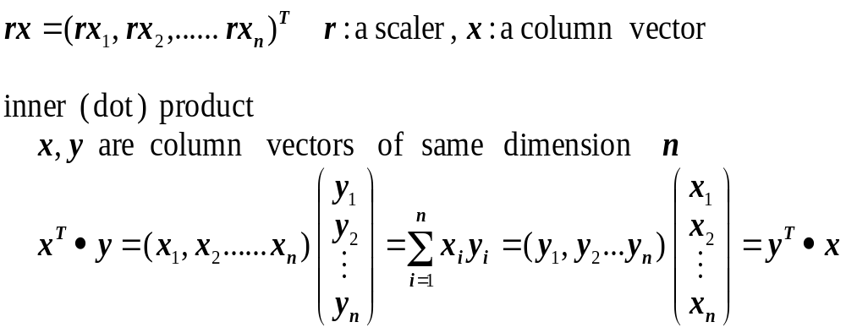
norms of a vector: (magnitude)
vector operations:

Slide 8

Cross product:
defines another vector orthogonal to the plan
formed by x and y.

Slide 9
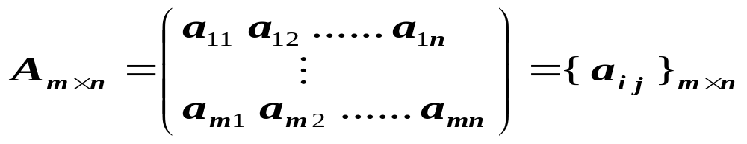
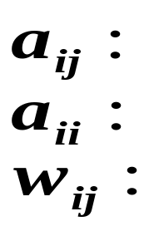
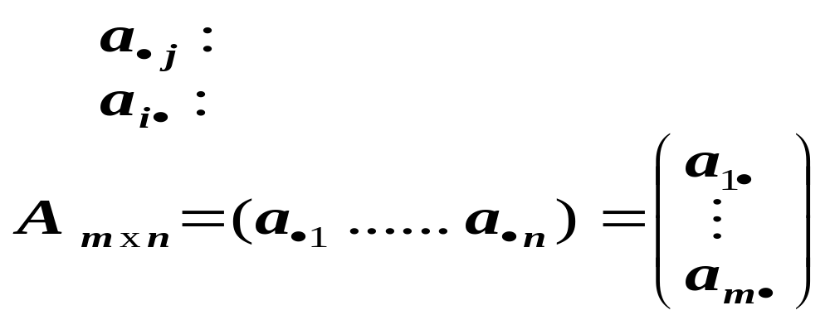
matrix:
the element on the ith row and jth column
a diagonal element
a weight in a weight matrix W
each row or column is a vector
jth column vector
ith row vector

Slide 10
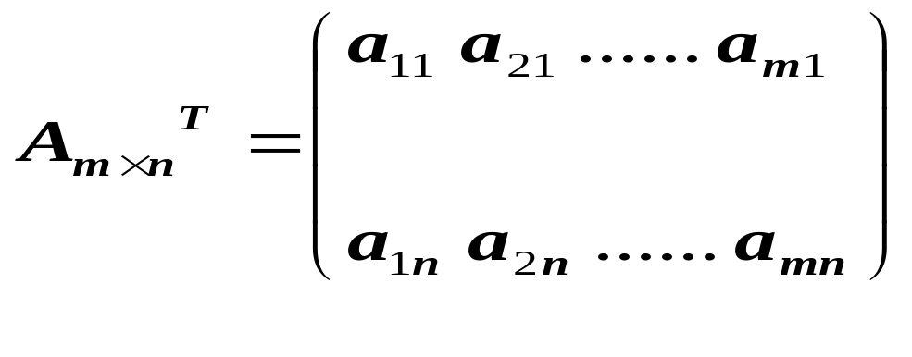
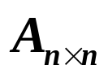
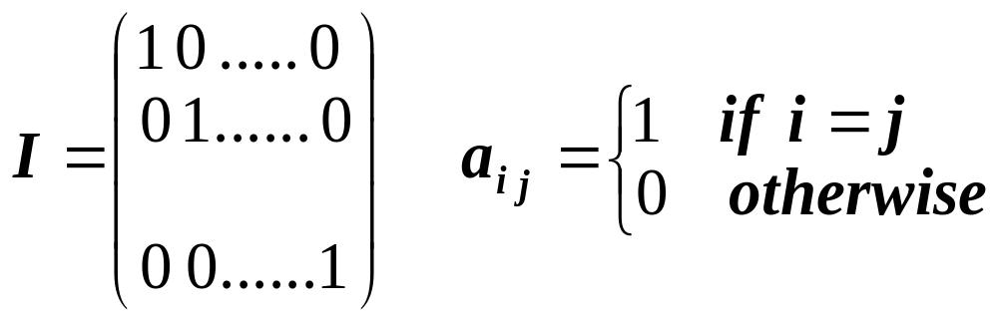
a column vector of dimension m is a matrix of mx1
transpose:
jth column becomes jth row
square matrix:
identity matrix:

Slide 11
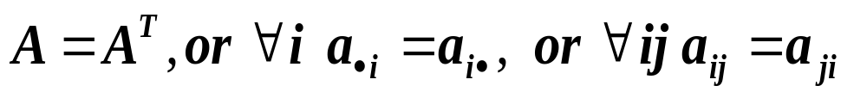
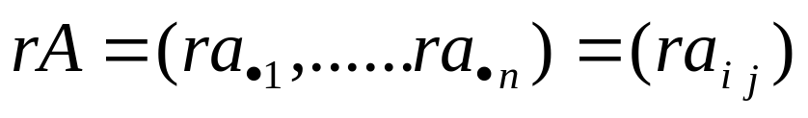
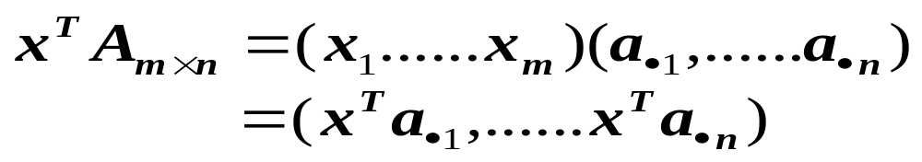
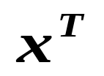
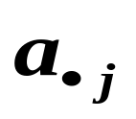
symmetric matrix: m = n
matrix operations:
The result is a row vector, each element of which is an inner product of and a column vector

Slide 12

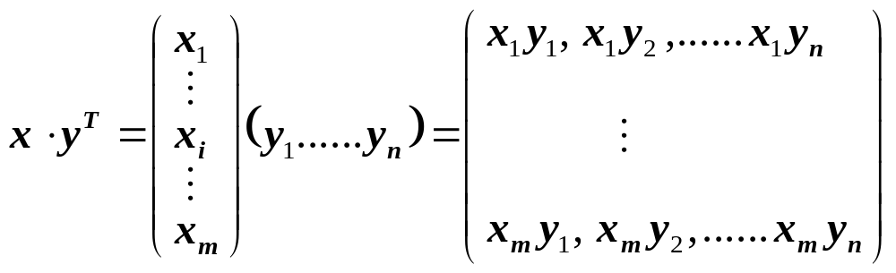
product of two matrices:
vector outer product:

Slide 13
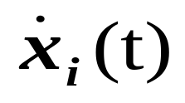
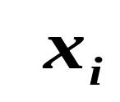

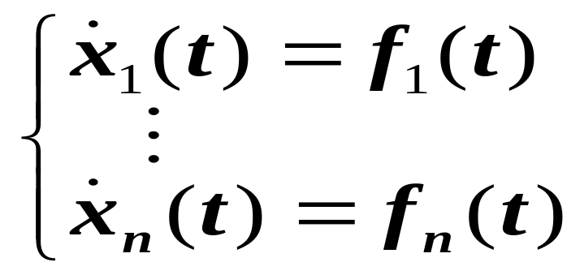
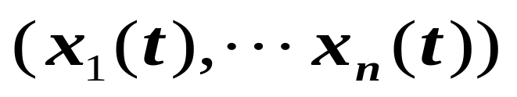
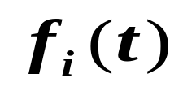
Calculus and Differential Equations
, the derivative of , with respect to time
System of differential equations
solution:
difficult to solve unless are simple

Slide 14
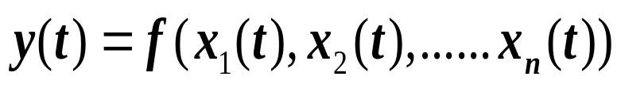
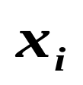
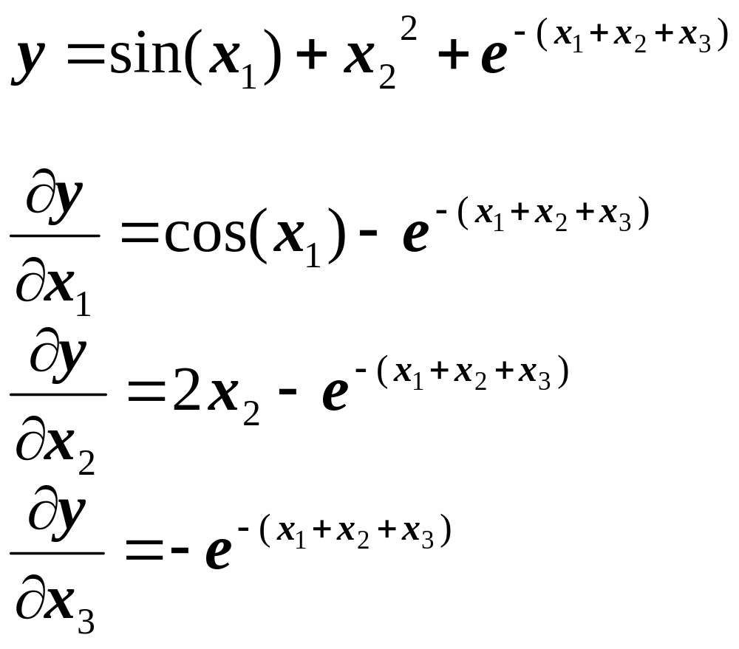
Multi-variable calculus:
partial derivative: gives the direction and speed of
change of y, with respect to

Slide 15
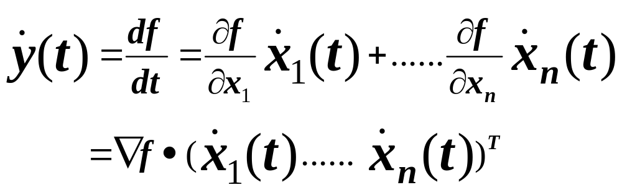
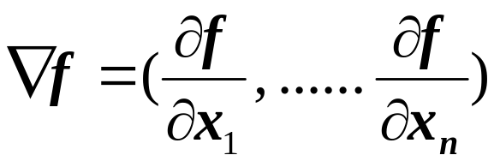
the total derivative:
Gradient of f :
Chain-rule: y is a function of , is a function of t

Slide 16
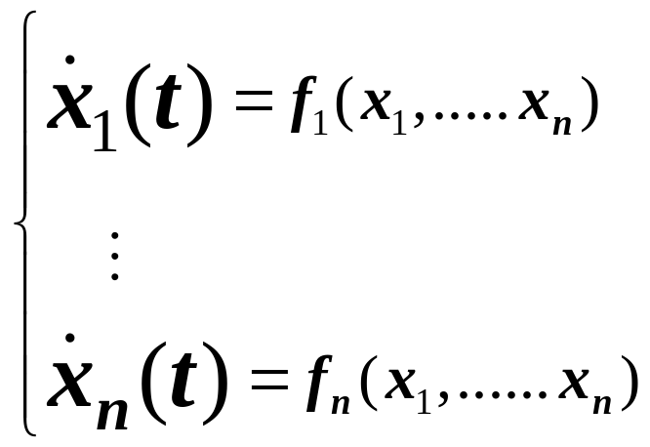

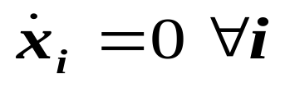
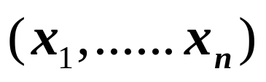
dynamic system:
  change of may potentially affect other x
  all continue to change (the system evolves)
  reaches equilibrium when
  stability/attraction: special equilibrium point
  (minimal energy state)
  pattern of at a stable state often represents a solution

Slide 17
Chapter 2: Simple Neural Networks for Pattern Classification
General discussion
Linear separability
Hebb nets
Perceptron
Adaline

Slide 18
General discussion
Pattern recognition
  Patterns: images, personal records, driving habits, etc.
  Represented as a vector of features (encoded as integers or real numbers in NN)
  Pattern classification:
    Classify a pattern to one of the given classes
    Form pattern classes
  Pattern associative recall
    Using a pattern to recall a related pattern
    Pattern completion: using a partial pattern to recall the whole pattern
    Pattern recovery: deals with noise, distortion, missing information

Slide 19



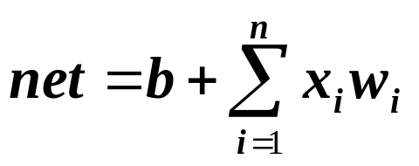

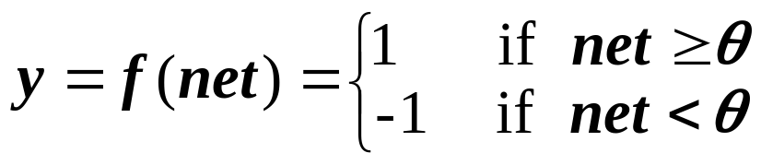
General architecture
Single layer
net input to Y:
bias b is treated as the weight from a special unit with constant output 1.
threshold related to Y
output
classify into one of the two classes
1
x1
Y
xn

Slide 20

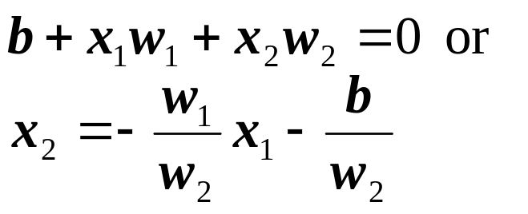




Decision region/boundary
  n = 2, b != 0, θ = 0
  is a line, called decision boundary, which partitions the plane into two decision regions
  If a point/pattern is in the positive region, then
  , and the output is one (belongs to class one)
  Otherwise, , output –1 (belongs to class two)
  n = 2, b = 0, θ != 0 would result a similar partition
+
-

Slide 21
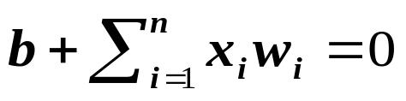
  If n = 3 (three input units), then the decision boundary is a two dimensional plane in a three dimensional space
  In general, a decision boundary is a n-1 dimensional hyper-plane in an n dimensional space, which partition the space into two decision regions
  This simple network thus can classify a given pattern into one of the two classes, provided one of these two classes is entirely in one decision region (one side of the decision boundary) and the other class is in another region.
  The decision boundary is determined completely by the weights W and the bias b (or threshold θ).

Slide 22
Linear Separability Problem
If two classes of patterns can be separated by a decision boundary, represented by the linear equation
then they are said to be linearly separable. The simple network can correctly classify any patterns.
Decision boundary (i.e., W, b or θ) of linearly separable classes can be determined either by some learning procedures or by solving linear equation systems based on representative patterns of each classes
If such a decision boundary does not exist, then the two classes are said to be linearly inseparable.
Linearly inseparable problems cannot be solved by the simple network , more sophisticated architecture is needed.

Slide 23
Examples of linearly separable classes
- Logical AND function
patterns (bipolar) decision boundary
x1 x2 y w1 = 1
-1 -1 -1 w2 = 1
-1 1 -1 b = -1
1 -1 -1 θ = 0
1 1 1 -1 + x1 + x2 = 0
- Logical OR function
patterns (bipolar) decision boundary
x1 x2 y w1 = 1
-1 -1 -1 w2 = 1
-1 1 1 b = 1
1 -1 1 θ = 0
1 1 1 1 + x1 + x2 = 0
o
x
o
o
x: class I (y = 1)
o: class II (y = -1)
x
x
o
x
x: class I (y = 1)
o: class II (y = -1)

Slide 24
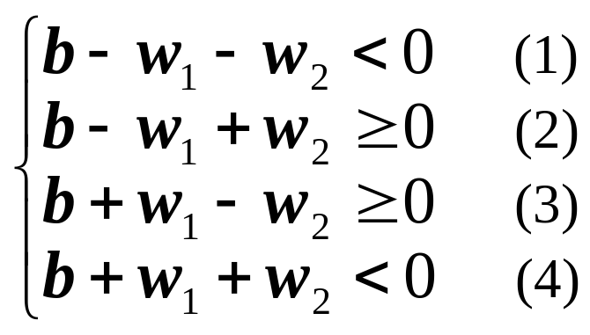
Examples of linearly inseparable classes
- Logical XOR (exclusive OR) function
patterns (bipolar) decision boundary
x1 x2 y
-1 -1 -1
-1 1 1
1 -1 1
1 1 -1
No line can separate these two classes, as can be seen from the fact that the following linear inequality system has no solution
because we have b < 0 from
(1) + (4), and b >= 0 from
(2) + (3), which is a
contradiction
x
o
o
x
x: class I (y = 1)
o: class II (y = -1)

Slide 25
  XOR can be solved by a more complex network with hidden units
θ = 1
x1
2
z1
2
θ = 0
-2
Y
-2
x2
z2
2
2
(-1, -1) (-1, -1) -1
(-1, 1) (-1, 1) 1
(1, -1) (1, -1) 1
(1, 1) (1, 1) -1

Slide 26


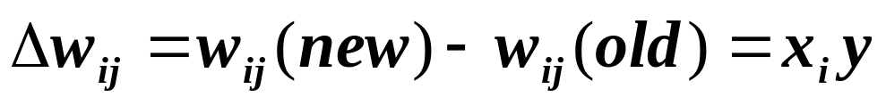
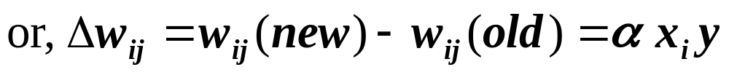
Hebb Nets
Hebb, in his influential book The organization of Behavior (1949), claimed
  Behavior changes are primarily due to the changes of synaptic strengths ( ) between neurons I and j
  increases only when both I and j are “on”: the Hebbian learning law
  In ANN, Hebbian law can be stated: increases only if the outputs of both units and have the same sign.
  In our simple network (one output and n input units)

Slide 27
Hebb net (supervised) learning algorithm (p.49)
  Step 0. Initialization: b = 0, wi = 0, i = 1 to n
  Step 1. For each of the training sample s:t do steps 2 -4
  /* s is the input pattern, t the target output of the sample */
  Step 2. xi := si, I = 1 to n /* set s to input units */
  Step 3. y := t /* set y to the target */
  Step 4. wi := wi + xi * y, i = 1 to n /* update weight */
  b := b + xi * y /* update bias */
  Notes: 1) α = 1, 2) each training sample is used only once.
Examples: AND function
  Binary units (1, 0)
(x1, x2, 1) y=t w1 w2 b
(1, 1, 1) 1 1 1 1
(1, 0, 1) 0 1 1 1
(0, 1, 1) 0 1 1 1
(0, 0, 1) 0 1 1 1
An incorrect boundary:
1 + x1 + x2 = 0
Is learned after using each sample once
bias unit

Slide 28
  Bipolar units (1, -1)
  It will fail to learn x1 ^ x2 ^ x3, even though the function is linearly separable.
  Stronger learning methods are needed.
    Error driven: for each sample s:t, compute y from s based on current W and b, then compare y and t
    Use training samples repeatedly, and each time only change weights slightly (α << 1)
    Learning methods of Perceptron and Adaline are good examples
(x1, x2, 1) y=t w1 w2 b
(1, 1, 1) 1 1 1 1
(1, -1, 1) -1 0 2 0
(-1, 1, 1) -1 1 1 -1
(-1, -1, 1) -1 2 2 -2
A correct boundary
-1 + x1 + x2 = 0
is successfully learned

Slide 29
Perceptrons
By Rosenblatt (1962)
  For modeling visual perception (retina)
  Three layers of units: Sensory, Association, and Response
  Learning occurs only on weights from A units to R units (weights from S units to A units are fixed).
  A single R unit receives inputs from n A units (same architecture as our simple network)
  For a given training sample s:t, change weights only if the computed output y is different from the target output t (thus error driven)

Slide 30
Perceptron learning algorithm (p.62)
  Step 0. Initialization: b = 0, wi = 0, i = 1 to n
  Step 1. While stop condition is false do steps 2-5
  Step 2. For each of the training sample s:t do steps 3 -5
  Step 3. xi := si, i = 1 to n
  Step 4. compute y
  Step 5. If y != t
  wi := wi + α ∗ xi * t, i = 1 to n
  b := b + α * t
  Notes:
  Learning occurs only when a sample has y != t
  Two loops, a completion of the inner loop (each sample is used once) is called an epoch
  Stop condition
  When no weight is changed in the current epoch, or
  When pre-determined number of epochs is reached

Slide 31






  Informal justification: Consider y = 1 and t = -1
  To move y toward t, w1should reduce net_y
  If xi = 1, xi * t < 0, need to reduce w1 (xi*w1 is reduced )
  If xi = -1, xi * t >0 need to increase w1 (xi*w1 is reduced )
Perceptron learning rule convergence theorem
  Informal: any problem that can be represented by a perceptron can be learned by the learning rule
  Theorem: If there is a such that for all P training sample patterns , then for any start weight vector , the perceptron learning rule will converge to a weight vector such that
  for all p. ( and may not be the same.)

Slide 32

Perceptron Convergence
Assume that η=1 after executing perceptron for k steps, weight vector is
Since given class are linearly separable, there must exist a vector w* that correctly classifies them, with sgn(w*.i_{k}) = class(i_{k}), where sgn is a step function whose outputs are 1 and -1
Taking the scalar product both sides with w*
For each input vector i_{j}, w*.i_{j} has the same sign as class(i_{j}). We can be assured that
1

Slide 33




Perceptron Convergence
There exists ε such that w*.x_{i} > ε for every member x_{i} of the training sequence. Hence
We may assume that
By Cauchy –Schwartz inequality
Assume that w* is of unit length, since the unit length vector also correctly classifies the same samples. Using this unit length vector assumption and previous two equations, we obtain the following lower bound
2
3
4
5

Slide 34




Perceptron Convergence
Since w_{j}=w_{j-1}+x_{j}, upper bound can be obtained for this vector squared length:
Since w_{j}-1.x_{j} < 0 whenever a weight change is required by the algorithm, we have
6

Slide 35


Perceptron Convergence
Summation of the inequalities over j=1,2,….k gives an upper bound
Hence, combining 5 and 7
Above inequalities show two conflicting requirements on the size of wk2. lower bound increases at the rate of k2 while upper bound is limited by k. in other words, there will be some k for which
7
8
9

Slide 36
Adaline
By Widrow and Hoff (1960)
  Adaptive Linear Neuron for signal processing
  The same architecture of our simple network
  Learning method: delta rule (another way of error driven), also called Widrow-Hoff learning rule
  The delta: t – y_in
    NOT t – y because y = f( y_in ) is not differentiable
  Learning algorithm: same as Perceptron learning except in Step 5:
    b := b + α ∗ (t – y_in)
    wi := wi + α ∗ xi * (t – y_in)

Slide 37





Derivation of the delta rule
  Error for all P samples: mean square error
    E is a function of W = {w1, ... wn}
  Learning takes gradient descent approach to reduce E by modify W
    the gradient of E:
    There for

Slide 38


How to apply the delta rule
  Method 1 (sequential mode): change wi after each training pattern by
  Method 2 (batch mode): change wi at the end of each epoch. Within an epoch, cumulate
  for every pattern (x(p), t(p))
  Method 2 is slower but may provide slightly better results (because Method 1 may be sensitive to the sample ordering)
Notes:
  E monotonically decreases until the system reaches a state with (local) minimum E (a small change of any wi will cause E to increase).
  At a local minimum E state, , but E is not guaranteed to be zero

Slide 39
Summary of these simple networks
Single layer nets have limited representation power (linear separability problem)
Error drive seems a good way to train a net
Multi-layer nets (or nets with non-linear hidden units) may overcome linear inseparability problem, learning methods for such nets are needed
Threshold/step output functions hinders the effort to develop learning methods for multi-layered nets

Slide 40
Why hidden units must be non-linear?
Multi-layer net with linear hidden layers is equivalent to a single layer net
  Because z1 and z2 are linear unit
  z1 = a1* (x1*v11 + x2*v21) + b1
  z1 = a2* (x1*v12 + x2*v22) + b2
  y_in = z1*w1 + z2*w2
  = x1*u1 + x2*u2 + b1+b2 where
  u1 = (a1*v11+ a2*v12)w1, u2 = (a1*v21 + a2*v22)*w2
  y_in is still a linear combination of x1 and x2.
x1
v11
z1
w1
θ = 0
v12
Y
v21
x2
z2
w2
v22

